Slide 1
Robotic Exploration
With Camera, Distance Sensor & Data Analysis
Jetson Nano with Jetbot

Slide 2
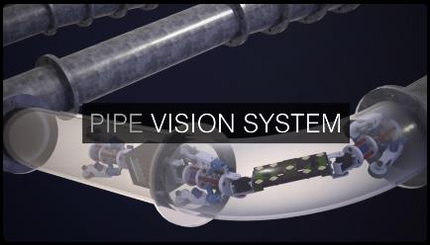
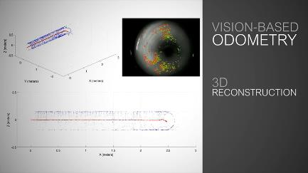
Robotic Exploration
Sometimes robots are sent into environments that are impossible or unsafe for humans.
For example, this Pipe Exploration robot can travel through gas pipelines and collect data on the integrity of the pipe infrastructure: https://vimeo.com/215521157
This data is then used to identify necessary repairs while avoiding excessive costs of digging up sections in need of no repair.
In this exercise, you will use a robot to collect visual data from an environment with limited human visibility.

Slide 3
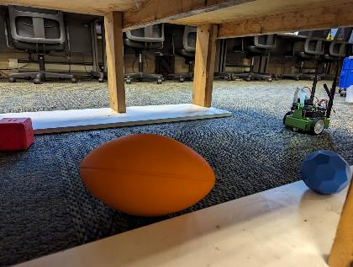
Exercise Overview
In the Autonomous Exploration exercise, you will configure your robot and its payloads (camera, light, distance sensor) to collect camera and distance sensor data from two environments with limited-or-no human visibility.
Environment 1: Small area, adequate lighting
Environment 2: Large area, poor lighting
The robot will move forward into the environment and then collect snapshots from its camera and distance sensor as it spins in place.
You will analyze the camera and distance sensor data through several processes and visualizations to ultimately generate a map of object locations.

Slide 4
Setup
Robotic Exploration

Slide 5
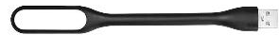
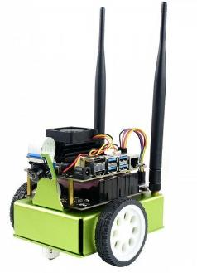
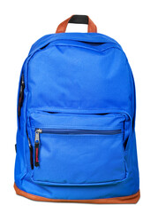
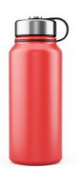
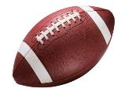
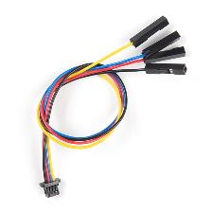
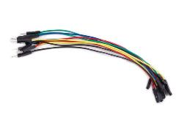
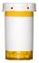
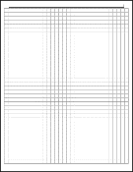
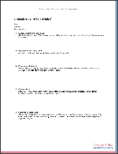
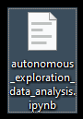
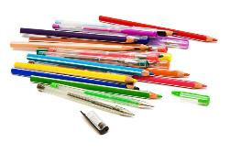
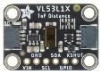
Materials Required
Flexible USB Lamp
Assorted Objects
Jetson Nano Jetbot
Flexible Qwiic Cable - Female Jumper (4-pin) and Breadboard Jumper Cables
Writing Utensils
Graph Paper
Robot Exercise Debrief
Jupyter Notebook
Adafruit VL53L1X Time of Flight Distance Sensor

Slide 6
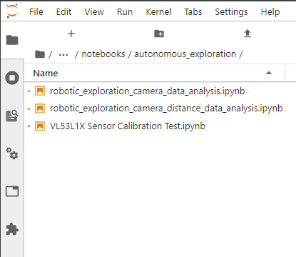
Software Setup
Connect to your Jetson Nano through Jupyter Notebooks.
If the VL53L1X Sensor Calibration Test and Robotic Exploration Investigation (with Camera, Distance Sensor and Enhanced Analysis) Jupyter Notebook is not already installed on your Jetson Nano, create an “autonomous_exploration” folder in your “notebooks” directory and upload them there.

Slide 7
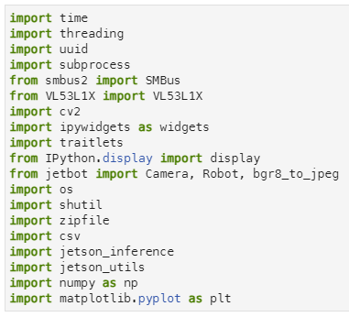
Software Setup
The Robotic Exploration Investigation (with Camera, Distance Sensor and Enhanced Analysis) Jupyter Notebook requires several Python Packages to be installed.
Ensure that you are using a Jetson image that contains these, or separately install them using pip3 commands.
Libraries:
Matplotlib
VL53L1X
Smbus2
Jetson_inference
Jetson_utils

Slide 8
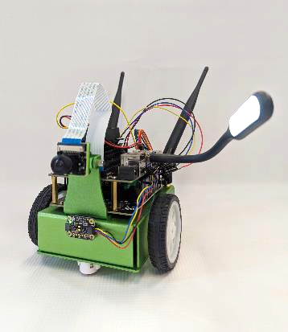
Payloads in Robotic Applications
Navigational Elements vs. Payloads:
Navigational Elements: Components that help the robot sense its environment or navigate through it. They directly impact the robot's movement and decision-making.
Examples: Motors, wheels.
Payloads: Components that add specific capabilities or functionalities to a robot but don't directly influence its navigation.
Camera: Captures snapshots of the robot's environment. Used for data collection and post-mission analysis, not for real-time navigation.
USB Light: Enhances the camera's visibility in dim environments. Ensures clarity of images but doesn't guide the robot's path.
Distance Sensor: Time of Flight sensor collects distance readings between the robot and a surface using a small laser

Slide 9
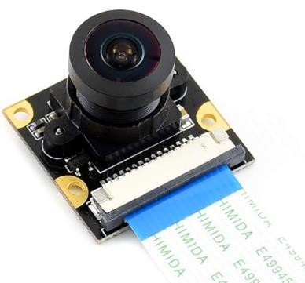
IMX219-160 Camera Specifications
Compact and efficient camera module that enhances the visual capabilities of the Jetson Nano.
Camera Specifications:
Sensor: Sony IMX219.
Resolution: 8 Megapixels (3280 × 2464).
Field of View (FOV): 160°.
Lens: CMOS size of 1/4 inch with an aperture of F2.35 and a focal length of 3.15mm.
Distortion: <14.3%​1​.

Slide 10
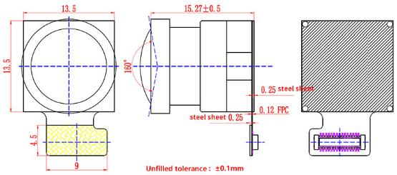
IMX219-160 Operating Conditions & Limitations
Optimal Conditions:
Temperature: 0°C to 50°C (Stable Image)
Adequate Lighting for High-Quality Images
Limitations:
Temperature Range: -20°C to 70°C
Low/Bright Lighting Affects Image Quality
Distortion: <14.3%
IR Sensitivity: Visible Light Only

Slide 11
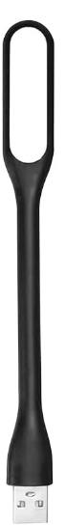
Flexible USB LED Lamp
Flexible body, the lamp may be twisted 360 degrees to adjust light direction.
Lamp Specifications:
Light Source Type: ‎LED
Connectivity: USB
Wattage: ‎1 watts
Voltage: ‎5 Volts (DC)
Brightness: ‎80 Lumen
Color Temperature: ‎5500 Kelvin

Slide 12
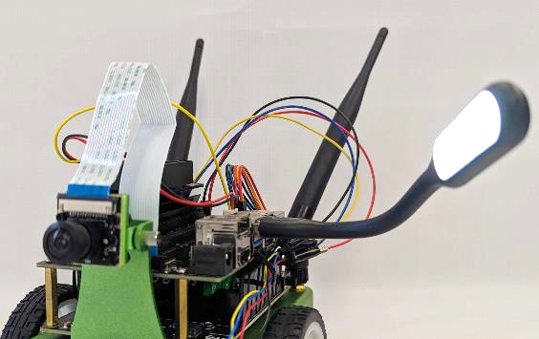
Hardware Setup
Ensure that the Camera on the Jetson Nano is facing outward, such that it can capture images of the robot’s surroundings.
Connect the USB Light to the Jetson Nano and orient it to illuminate the camera’s field of view.

Slide 13
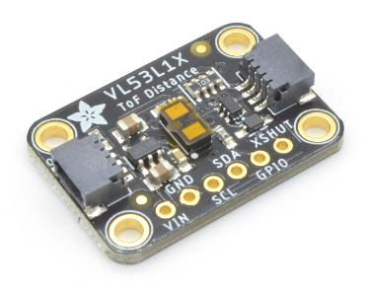
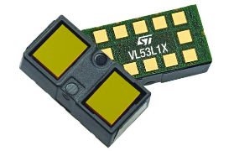
VL53L1X Time-of-Flight Distance Sensor
A state-of-the-art distance sensor utilizing Time-of-Flight (ToF) technology.
Works by measuring the time it takes for emitted light to reflect off an object and return.
Measures distances from 40mm to 4m with high accuracy.
27-degree Field-of-View

Slide 14
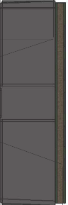
VL53L1X Time-of-Flight Distance Sensor
The sensor emits a pulse of light.
Measures the time taken for the pulse to bounce off an object and return.
Uses this time measurement to calculate distance.
Sensor
Emitter
Elapsed Time?
Receiver
Object

Slide 15
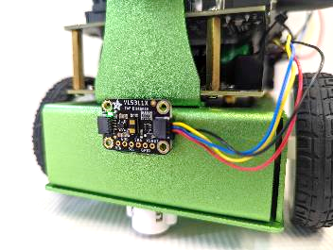
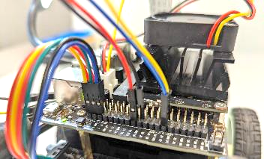
Connecting VL53L1X to Jetson Nano
Secure the VL53L1X Distance Sensor to the front of the robot, with the sensor name facing up.
Use the Qwiic Cable to connect the sensor to the Jetson GPIO. Breadboard Jumper cables may be used to extend the length.
Black Wire (GND): Connects to any GND pin on the Jetson Nano.
Red Wire (3.3V): Power the sensor by connecting to a 3.3V pin on the Nano.
Blue Wire (SDA): Data line, connects to Pin 27 on the Nano.
Yellow Wire (SCL): Clock line, connects to Pin 28 on the Nano.

Slide 16
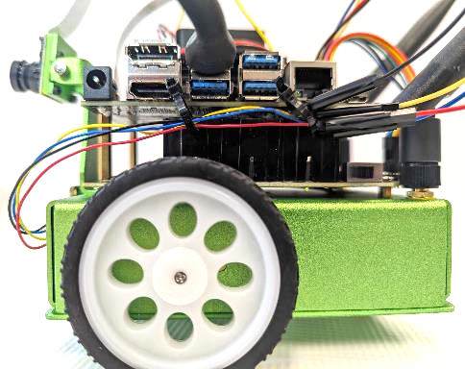
Connecting VL53L1X to Jetson Nano
If you used Breadboard Jumper Cables to extend the length the length of the cables, electrical tape may be used to ensure the connection holds as the robot moves.
Ensure that the cables connecting the sensor to the Jetson GPIO are not at risk of entanglement with the wheels or other components.

Slide 17
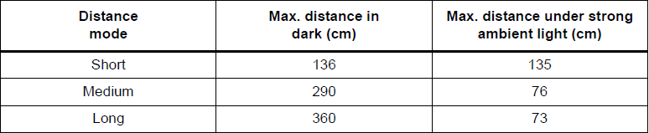
Sensor Range and Accuracy Factors
Optimal Conditions:
Indoors with controlled lighting.
Away from reflective surfaces.
Stable power supply.
Limitations:
Accuracy decreases with increased ambient light.
Reflective surfaces can cause false readings.
Limited to a maximum distance of ~4 meters.

Slide 18
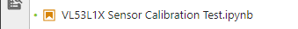
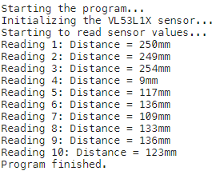
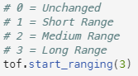
VL53L1X Sensor Calibration
Open the VL53L1X Sensor Calibration Test Jupyter Notebook.
The code included initializes the VL53L1X Distance Sensor and outputs 10 sensor readings (1 per second for 10 seconds). Run the code to ensure that the sensor is working and providing accurate distance readings.
The value in the “start_ranging()” command controls whether the distance sensor is calibrated for short, medium, or long-distance ranges and may be modified based on your environment and testing.

Slide 19
Procedures
Robotic Exploration

Slide 20
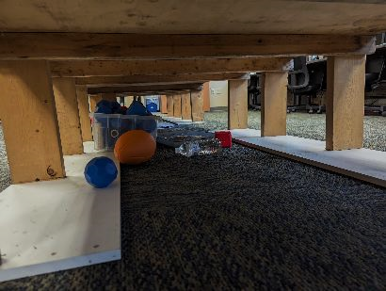
Investigation: Environment 1
In this Investigation, you will collect camera and distance sensor data from two separate environments with limited-or-no human visibility.
Environment 1: Small area, adequate lighting
Environment 2: Large area, poor lighting
This process will help you to better understand how the different sensors perform under these conditions, allowing you to generate plans that leverage the strengths of the sensors and system.
Begin by placing your robot in Environment 1.

Slide 21
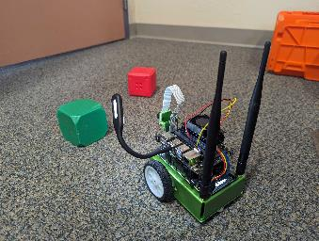
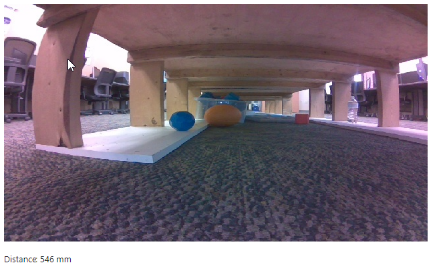
Robot and Camera Calibration
Begin running Robotic Exploration Investigation (with Camera, Distance Sensor and Enhanced Analysis) Jupyter Notebook
Place the robot in a known location with objects in view.
Run the steps through the “3. Raw Data Visualization” section of the notebook to set up the distance sensor, robot and camera.
Verify that the view in the camera widget is working, properly angled and illuminated to capture the robot’s surroundings.
Adjust the camera and USB light as necessary.

Slide 22
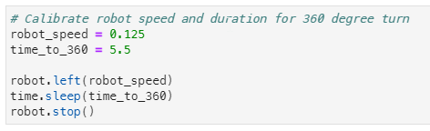
Robot Turn Calibration
Run the “4. Robot Movement Calibration” section of the notebook to find the appropriate values for robot_speed and time_to_360.
Adjust the robot_speed and time_to_360 variables until the robot very slowly creates a full 360 degree turn.

Slide 23
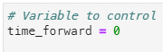
Adjust Time Forward Parameter
The code block under the “5. Raw Data Collection” section of the notebook contains a variable that allows you to rapidly adjust how far the robot should travel before collecting data.
Adjust this parameter so that the robot travels the correct duration forward.

Slide 24

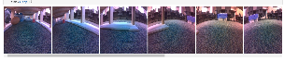
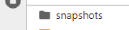
Run Exploration Routine
Place the robot in the environment with limited visibility.
Run the code block in the Jupyter Notebook under “5. Raw Data Collection”.
Snapshot images from the camera at each interval will appear in a “snapshots” folder.
Run the code block in the Jupyter Notebook under “6. Raw Data Display” to inspect the frames and corresponding distances captured
Step 7 stops the camera to free up resources and Step 8 generates a video of the frames.

Slide 25
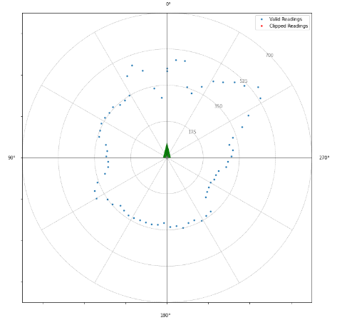
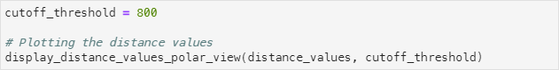
Analysis: Generate 2D Polar Grid
Steps 9 and 10 generate a 2D Polar Grid of the Distance Sensor readings. The green triangle in the center represents the starting orientation of the robot, and the dots around it represent the distance sensor readings taken as the robot spins.
The “cutoff_threshold” variable in Step 10 may be adjusted to set an appropriate range for the grid and “clip” far-out values (represented as red dots).

Slide 26
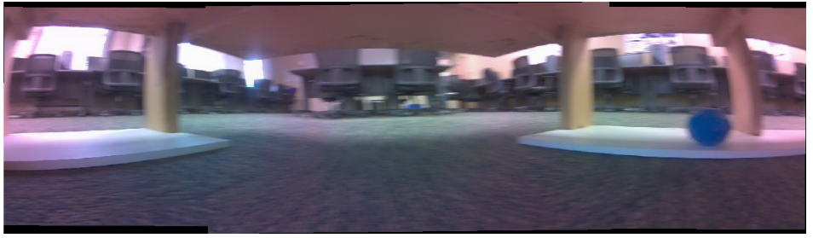
Analysis: Generate Panoramic Image
The “11. Image Analysis Panorama” step of the notebook generates a panoramic image from the snapshot images collected. The number of frames used is configurable and will take some time to complete. After processing, the image should appear in the notebook.

Slide 27
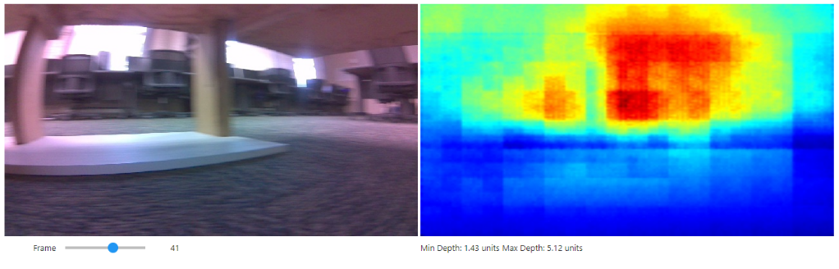
Analysis: Generate Depth Maps
Steps 12 – 14 load the DepthNet Model and run an algorithm to process each frame for estimated minimum and maximum distances, represented as a Depth Map, similar to a Heat Map.

Slide 28
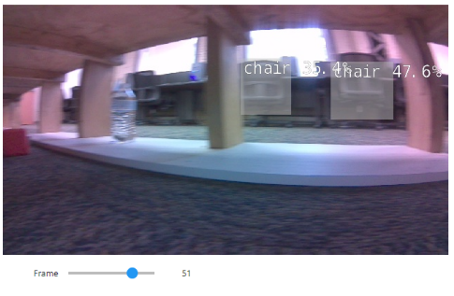
Analysis: Perform Object Recognition
Steps 15 – 17 load the MobileNet Model and run an algorithm to process each frame for identifiable objects. The “threshold” value in Step 15 may be adjusted to increase or decrease the necessary confidence score for recognition.

Slide 29
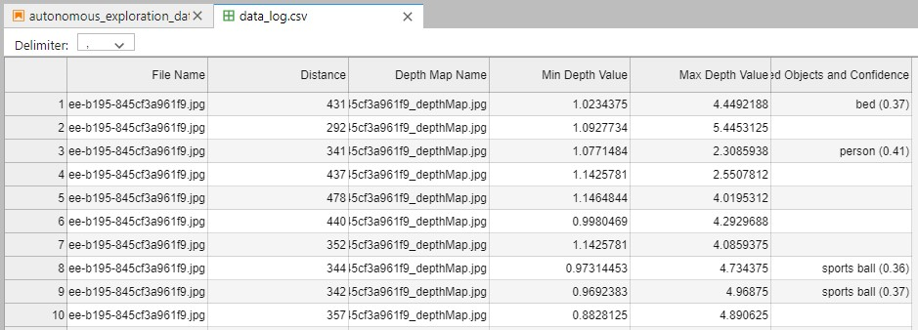
Analysis: Generate Data Log
Data Log text

Slide 30
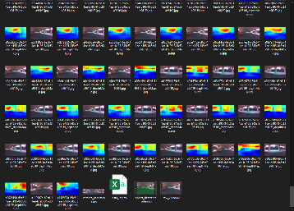
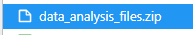
Analysis: Generate Data Archive
Step 18 generates a CSV log of all data gathered and processed during the investigation, and Step 19 compresses the log and other data into a single ZIP file for convenient download.

Slide 31
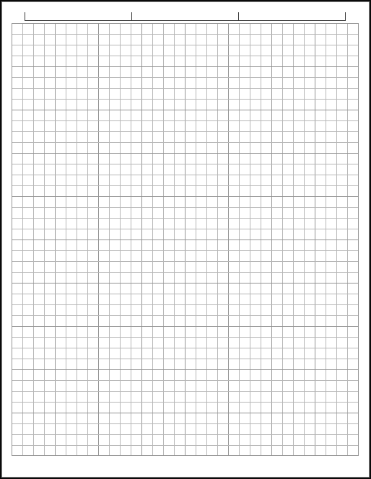
Manual Analysis: Generate Map
Choose a scale that allows your environment to fit on the graph paper.
Use writing instruments to add landmarks to the graph paper that provide reference points.
Represent the path that the robot took with an arrow.
Use the data you captured and analyzed to map and label objects from the environment.

Slide 32
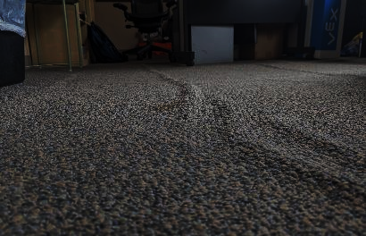
Investigation: Environment 2
After processing all data from Environment 1, it is time to move on to Environment 2:
Environment 1: Small area, adequate lighting
Environment 2: Large area, poor lighting
Move your robot to Environment 2.
Complete all the procedures to capture and analyze data in Environment 2.

Slide 33

Store and Disseminate Data
Complete the Robotics Exercise Debrief. Make sure to include all data and the map you generated. Use appendices as necessary.
Upload the Robotics Exercise Debrief, along with the data to the classroom server.
E-mail the instructors to share this data.

Slide 34

Sensor Mapping Challenge
In this challenge, participants must generate a map by collecting and analyzing sensor data from 3 connected areas.
Some areas of the map have lighting limitations.
Participants must generate a plan for which sensors and analysis they will use at each area, as well as the necessary procedures to carry out their plan.
Joystick Control with Camera may be used to navigate the robot from one area to the next, but direct visibility is not permitted.
Turn in the resulting map and all data collected during the challenge.
A
B
C

